Slide 1
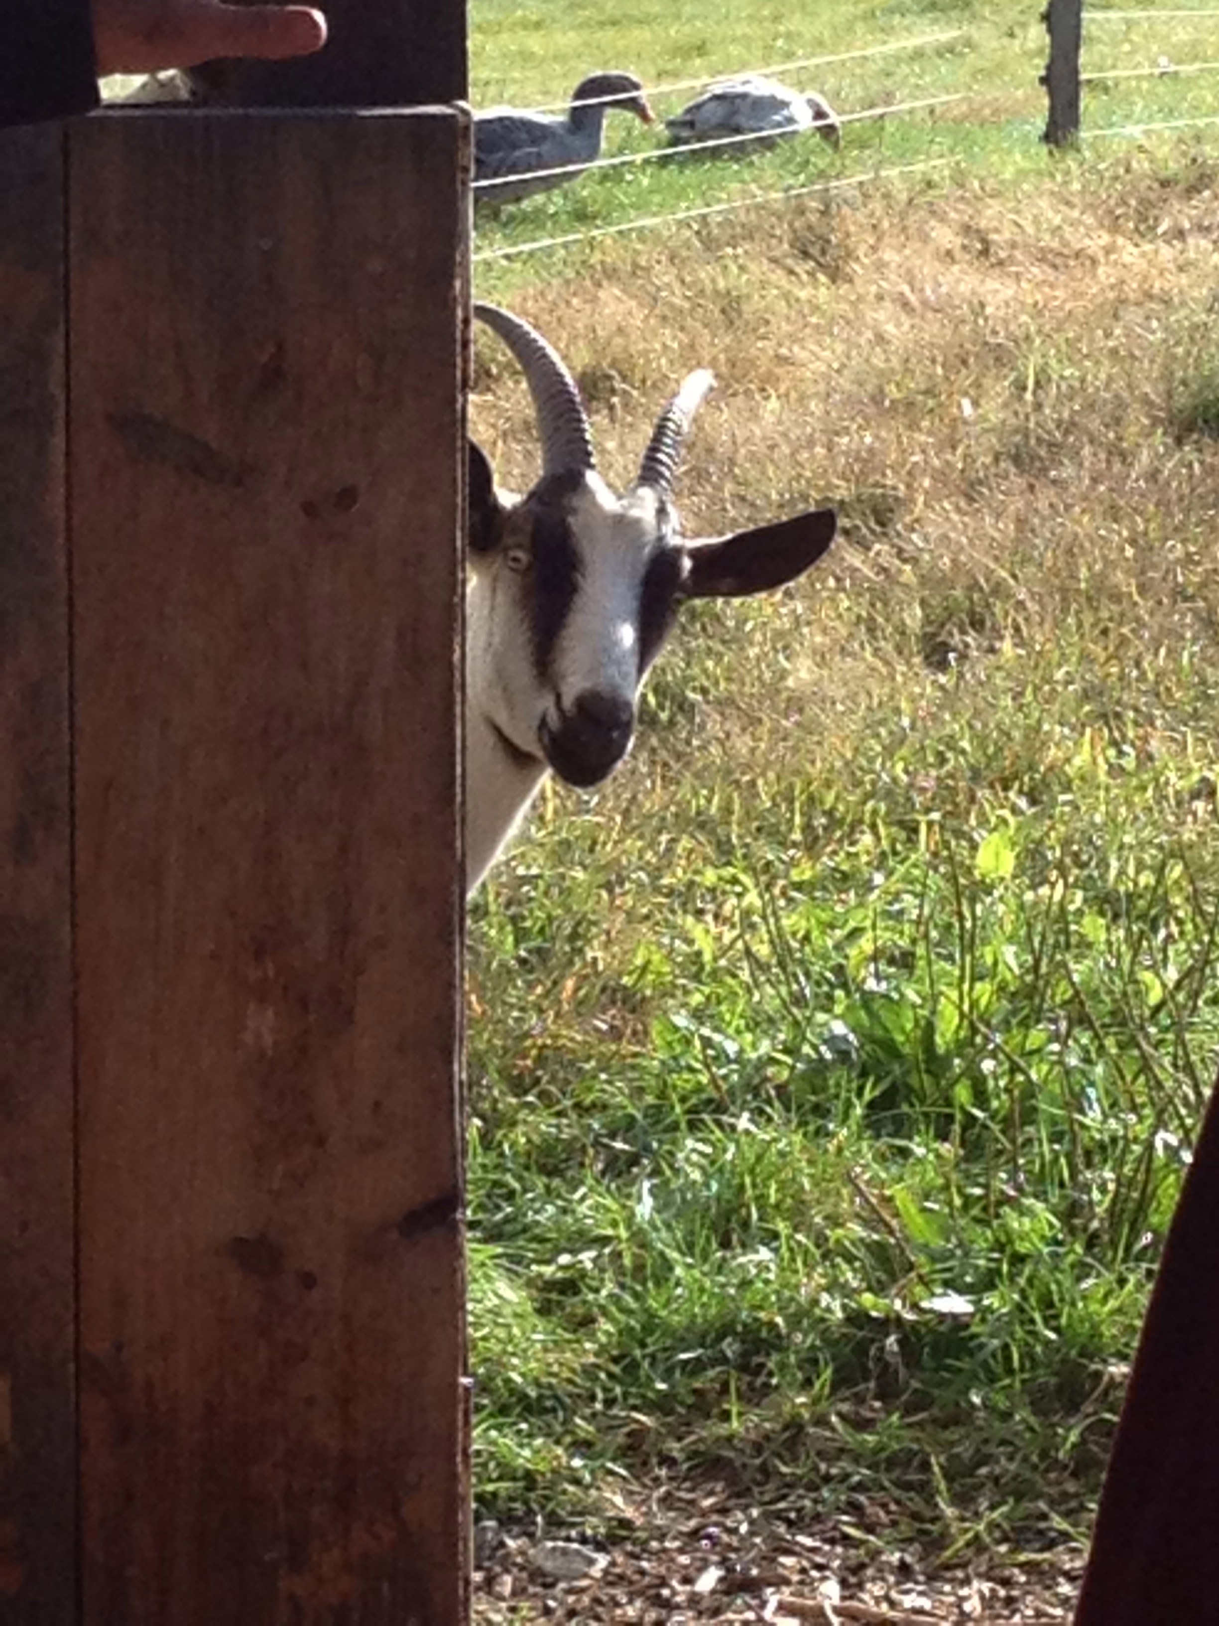
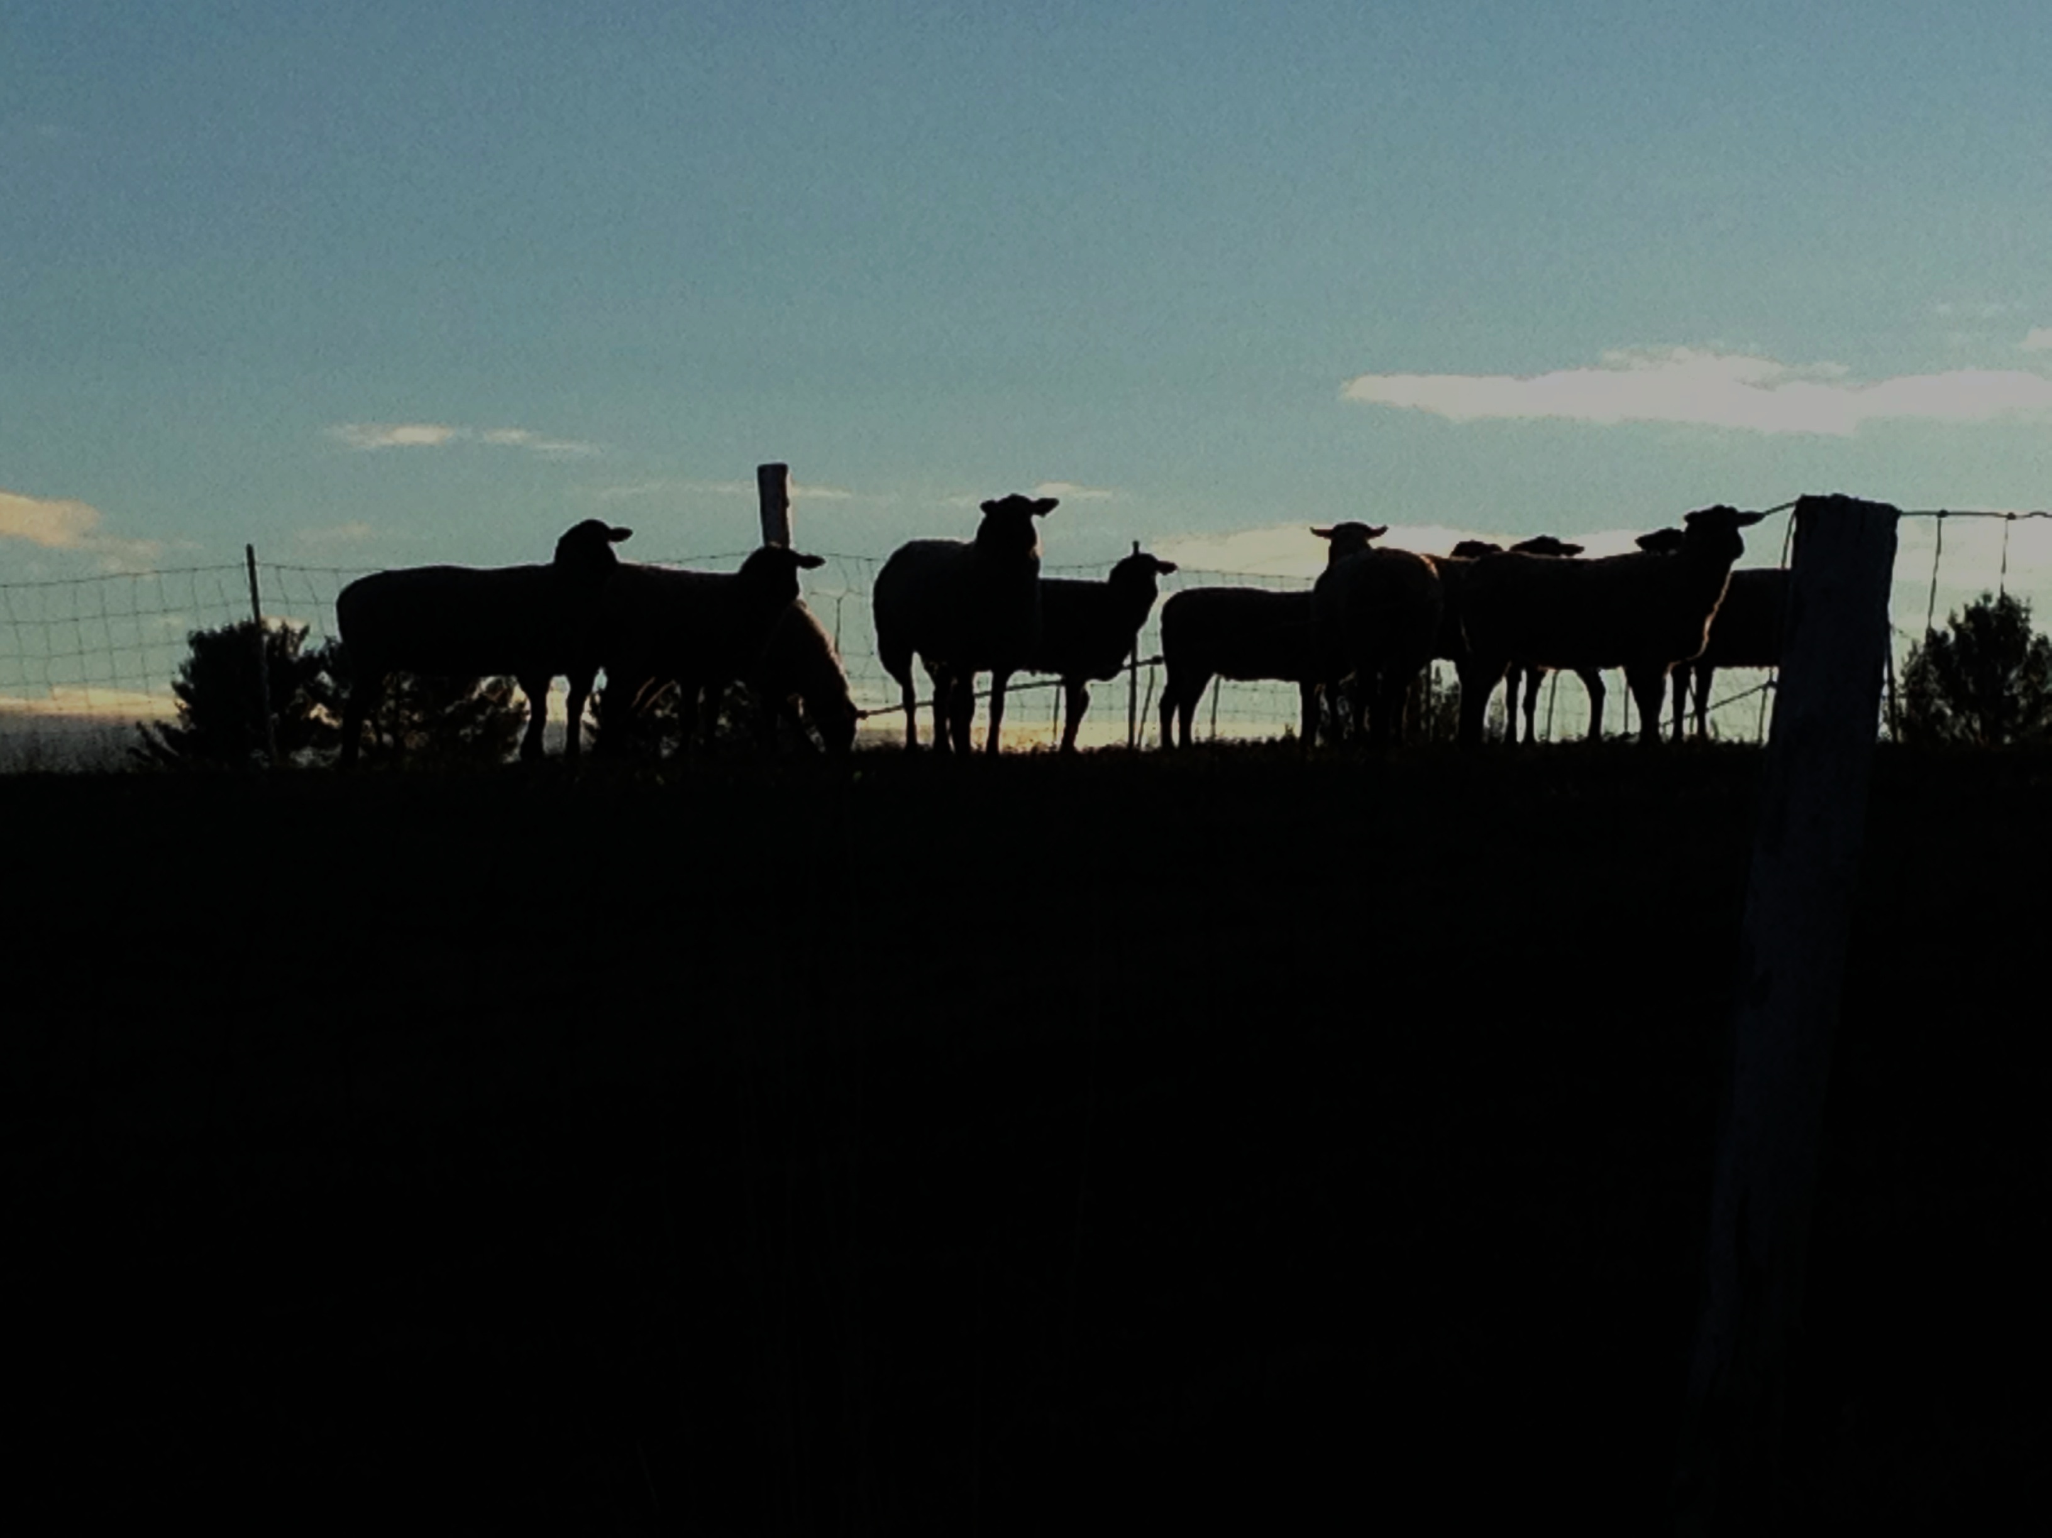
Are Sheep or Goats in Your Farming Future?
Dr. Richard Brzozowski,
Small Ruminant Specialist
University of Maine Cooperative Extension; richard.brzozowski@maine.edu

Slide 2
Session Goals – in 40 minutes
Participants will . . .
be equipped with basic information for successful sheep and goat production.
help to generate a list of ways to minimize the physical demands of the farmer for sheep or goat production.
leave better equipped to make sound decisions for their farming operation.

Slide 3
Let’s explore the feasibility of a sheep or goat enterprise for your farm or ranch operation. Beware: Just because we are talking sheep & goats doesn’t mean these species are profitable for all farmers.

Slide 4
If you raise sheep or goats, what can you sell or provide as a service?
Meat
Dairy products (milk, cheese, yogurt, pudding, etc.)
Fiber
Breeding stock
Other . . . such as hides, soap, agritourism, serum, plasma, blood, biomedical research, semen, breeding service, etc.

Slide 5
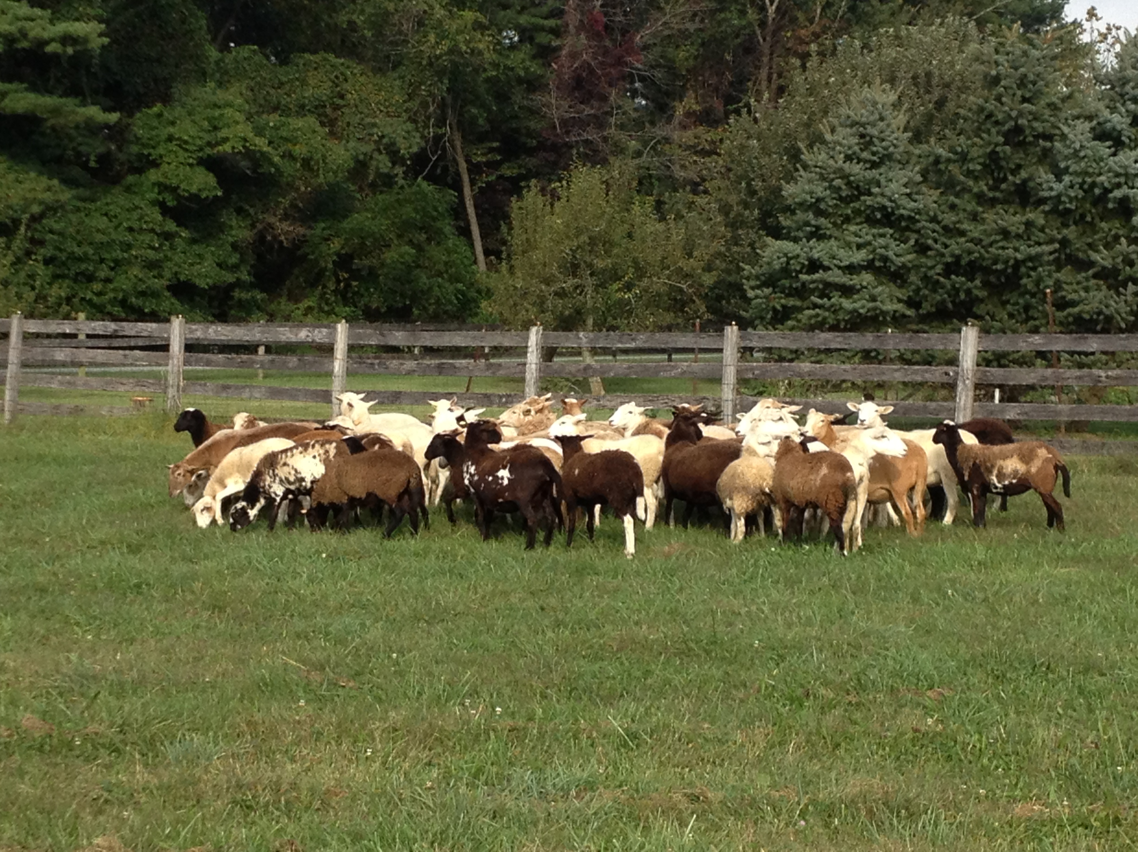
Identify the purpose of your enterprise
Design your enterprise to meet this purpose(s).

Slide 6
Market – Your Starting Point
If you don’t have a market (someone to buy your product or service), you will not remain in business.
If you want to be in business, you need to identify & cultivate potential or existing market(s). Who are they? Determine . . .
What will they buy?
What price are they willing to pay?
How much they will buy?
When will they buy? schedule, frequency, etc.

Slide 7
Secure more than one market or sales outlet.
Having two or more markets (buyers) reduces your risk.
Having more than one market can provide a more consistent cash flow.
Having two or more markets helps promote your products more widely. Expanding your customer base.

Slide 8
Marketing options for live animals
WHOLESALE (commodity)
RETAIL (Direct to consumer)
MIDDLEMAN
Local sale barn
Graded sale
Terminal sale
Broker, Dealer
Abattoir
Co-op
On-farm
Live market
Freezer trade
Ethnic markets
Weekly sale
Special sale
Live price
Carcass price
Direct marketer
Convenience
Control
Credit: Susan Schoenian

Slide 9
Marketing options for carcasses and meat
WHOLESALE
(whole carcass)
RETAIL
(meat, cuts)
Consumer
Consumer
Restaurant
Retail store
Restaurant
Retail store
Farm store
Farmer’s market
CSA (delivery)
Food Service
Internet
Income
Costs
Labor
Credit: Susan Schoenian

Slide 10
Marketing options for dairy products
You have 2 basic options for selling dairy products:
Direct to consumers (fluid milk, cheese, etc.)
Sold to a processor
Start at your state department of agriculture; food inspection services
Obtain written regulations
Meet the inspector for your region
Invite inspector to your premises, show plans, ask questions

Slide 11
Farm Business Planning – Your Second Step
This planning . . .
is confidential.
takes place on paper through research, fact-finding, surveys, interviews, etc.

Slide 12
Your Farm Business Plan: “snap shot”
Who will produce/grow?
How much will be produced/grown?
To whom will you sell? Where will it be sold? For what price will it be sold? [marketing plan]
What is your projected income and expenses (cash flow statement by the month)?

Slide 13
Determining Species – Sheep or Goats?
Similarities
145 to 150-day gestation cycle
Mostly seasonal breeders
Common diseases
Meat flavor
Consumers of their meat
Predators
Differences
Dairy goats have better milk production
Goats require more copper
Goats are browsers; sheep are grazers
Sheep > gregarious
Chromosome numbers

Slide 14
What size flock or herd is best for me?
Considerations
Land base or availability – pasture, forage production (winter feed)
Breeding groups
Production groups (sorted by age, sex, stage, etc.)
Facilities (availability, type and size)
Adequate space for animals (for winter months at a minimum)
Adequate space for stored winter feed
Time demands (labor & management)
Physical demands (chores, handling, etc.)

Slide 15
Further considerations in determining enterprise size & scale
How much income do I hope to make/year with sheep or goats?
Determine a gross income from the enterprise. Then calculate a reasonable net income.
Income is based on price and quantity of the products you sell; minus your costs
Do I have room to expand if needed?
There can be numerous costs with livestock. Returns can be variable or non-existent.

Slide 16
Required inputs for sheep & goats
Animals (breeding stock, feeder stock)
Feed
Forage – pasture, hay, silage, etc.
Grains – for specific times; stages of production
Minerals – species specific
Water
Space – land and facilities
Labor – feed, milk, handle, clean, process, sell, care
Protection from the elements
Medical attention (you or a veterinarian)
Tools & equipment

Slide 17
The physical demands of the farmer in raising sheep or goats.
Review typical activities list involved in raising sheep or goats. Efficiency, safety & economy are your goals.
Which tasks could YOU perform?
Which tasks could be “hired” out or performed by others?
Which tasks could YOU perform with assistive technology, animals, tools or equipment?

Slide 18
Possible helps for the shepherd or goat herdsman
Assistive technologies
Animals (herding, guarding, assisting)
Tools
Equipment (labor saving, energy saving, etc.)
Employees, assistants or family members
Other

Slide 19
So now what?
Based on these demands, could raising sheep or goats be a feasible enterprise (for you and your situation)?
Is more research required for you to make a wise decision?
Are there other farming enterprises that fit better?

